Slide 1
CS31110: Object Oriented Analysis and Design
Module Overview
Chris Loftus (cwl, C47)

Slide 2
Overview
Problems with software development
A classification of processes: spectrum from none (hacking) through to lightweight agile processes and then to heavyweight prescriptive processes
We will focus on Agile Processes. What does the Agile Alliance say?
Module objectives
Module contents
Booklist

Slide 3
Problems with software development
Most systems are delivered late, over budget or not at all
Why so?
  Lack of coherent development process
  Too prescriptive and heavyweight process followed that demands unreasonable amounts of documentation
  Inappropriate up-front detailed requirement specification, design and rigid planning
  Lack of involvement of customer during development

Slide 4
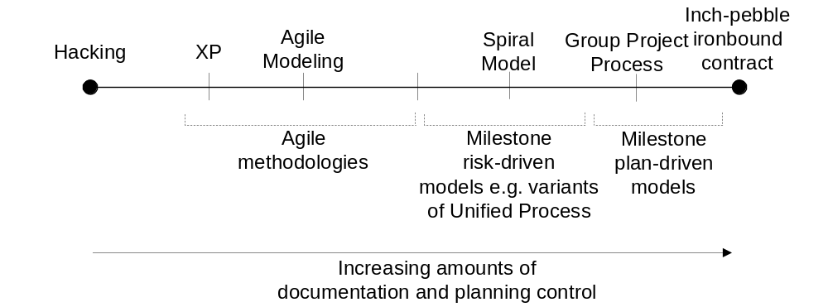
The planning spectrum
See IEEE Computer, Jan 2002, Barry Boehm

Slide 5
Agile Software Development Alliance
www.agilealliance.org
Manifesto for encouraging better ways of developing software:
  Individuals and interactions over processes and tools
  Working software over comprehensive documentation
  Customer collaboration over contract negotiation
  Responding to change over time

Slide 6
Agile Alliance principles
Our highest priority is to satisfy the customer through early and continuous delivery of valuable software
Welcome changing requirements, even late in development. Agile processes harness change for the customer’s competitive benefit
Deliver software frequently, from a couple of weeks to a couple of months
Business people and developers must work together daily throughout the project
Build projects around motivated individuals

Slide 7
Agile Alliance principles (cont)
The most efficient and effective method of conveying information to and within a development team is face-to-face conversation
Working software is the primary measure of progress
Agile processes promote sustainable development
Continuous attention to technical excellence and good design enhances agility

Slide 8
Agile Alliance principles (cont)
Simplicity – the art of maximizing the amount of [unnecessary] work not done – is essential.
The best architectures, requirements and designs emerge from self-organising teams
At regular intervals, the team reflects on how to become more effective, and then tunes and adapts its behaviour accordingly

Slide 9
Module objectives
I believe that agile modelling is the most appropriate way to develop software for many projects
Consequently, will focus on specific recent and well-known agile modelling process: Extreme Programming (XP) and Agile Modeling
However, Boehm argues for more plan-based control in certain circumstances. We will look at his arguments at the end of the module.
Will provide an overview towards end of the module of Unified Process: a more plan-based model

Slide 10
Module content
XP overview and planning
L2 to L3: Background on XP
L4: XP project planning
P1: Introduction to Together
P2: The Planning Hour Game
  Tutorial-based exercise 14-18th October as a way of trying out XP’s ideas on planning

Slide 11
Module content
XP testing and pair programming
L5: Test-driven development in XP
  Key feature of XP
  Will illustrate using Together’s Testing Framework
P3: Using Together’s Testing Framework
L6: Pair programming in XP
  Will also overview Practical 2

Slide 12
Module content
Refactoring and integration
L7 to L9: Refactoring
  A key XP practice, but used much more widely
  Improving design of code to make it more amenable to change
  Will go through a detailed example
  And will then discuss principles
L10: XP: Continual integration and staying on process
P4: Refactoring exercise

Slide 13
Module content
Agile Modeling and Design
L11: Overview of Agile Modeling
L12: Classes, Relationships and Collaborations (CRC) technique
P5: CRC tutorial exercise
L13: More on Agile Modeling practices

Slide 14
Module content
Design patterns and frameworks
L14 to L17: Design patterns and frameworks.
  DP: Reuse of design expertise to a commonly occurring problem
  Framework: Reuse of generic set of classes
P6 to P7: Use of design patterns and a framework

Slide 15
Module content
Unified Process
L18: Agile Modeling and lightweight documentation
L19 to L23: Unified Process overview
  Overview
  Use Cases and their realization
  UP and architecture
  Boehm’s discussion on choosing the right methodology

Slide 16
Book List
Extreme programming applied, Ken Auer, Roy Miller, Addison Wesley
Agile Modeling, Scott Ambler, Wiley
The Rational Unified Process, An Introduction, Philippe Kruchten, Addison Wesley
Refactoring, Martin Fowler, Addison Wesley
Java Design Patterns, Vol 1, Mark Grand, John Wiley and Sons

